Slide 1
Direct Digital Synthesis
Primer
Based on slides by Ken Gentile et al, Analog Devices Inc.

Slide 2
Contents
Introduction to DDS
Fundamental DDS Architecture
Spectral Characteristics
DDS as a Building Block

Slide 3
Introduction to DDS
Definition of DDS:
A digital technique for generating a sine wave from a fixed-frequency clock source.

Slide 4
Phase ∝ Time
F_{out}
TIME
360
θ = 360t*F_{out}
PHASE
0
TIME
Notes:
Within a period of a sinewave, the phase is directly proportional to time.

Slide 5
Discrete Phase ∝ Discrete Time
F_{out}
TIME
2^{n}-1
PHASE
0
TIME
Notes:
The same is true in a discrete time system. It takes 2^{n} clock periods to give one output period. In this illustration, n=5, so it takes 32 clock cycles to get one full output cycle.

Slide 6
How do you build this?
2^{n}-1
PHASE
0
TIME
PHASE ACCUMULATOR
Example: n = 24 or 48 BITS
n
n
PHASE REGISTER
n
1
CLOCK
F_{clk}
Notes:
This is built using a simple accumulator (aka counter). After 2^{n} counts (32 in this illustration), the counter overflows and starts from zero again.

Slide 7
Changing Frequency
2^{n}-1
PHASE
0
TIME
PHASE ACCUMULATOR
n = 24 to 48 BITS
(typically)
n
n
DELTA PHASE REGISTER M
n
PHASE REGISTER
n
M
M
CLOCK
FREQUENCY CONTROL M = TUNING WORD
F_{clk}
Notes:
We can get a higher frequency by using a larger phase increment (4 in this case). The equation looks suspiciously like the Mth bin of an FFT, which is another way to look at this. For very large n, the FFT bin size is very, very small, allowing for very fine frequency resolution. Note that when we change M, the frequency changes, not the phase (i.e., the accumulator contents).

Slide 8
Getting a Sinewave Output
AMPLITUDE
0
TIME
PHASE ACCUMULATOR
n = 24 to 48 BITS
(typically)
n
n
DELTA PHASE REGISTER M
n
PHASE REGISTER
n
p
PHASE-TO
AMPLITUDE
CONVERTER
M
CLOCK
FREQUENCY CONTROL M = TUNING WORD
F_{clk}
Notes:
But of course, we want the output to be amplitude, not phase. The phase-to-amplitude converter is often referred to as a sine lookup table but it takes less silicon to perform an algorithm compared to ROM. Still, it takes a lot of silicon to perform this using all n bits (where 24<n<48). Therefore the phase is truncated to p bits first. To convert the amplitude numbers to amplitude voltage, a DAC placed at the output.

Slide 9
Fundamental DDS Architecture
Basic DDS building blocks:
Accumulator
a digital block consisting of an adder with feedback
Phase-to-Amplitude converter
a digital block that converts digital phase values to digital amplitude values
DAC (Digital-to-Analog Converter)
a digital/analog hybrid that converts digital “numbers” to a scaled analog quantity (voltage or current)
Converts the sampled sine wave generated by the digital blocks to a continuous (analog) signal.

Slide 10
Signal Flow Through the DDS Architecture
M
F
clk
F
o
=
2
n
REFERENCE
CLOCK
F
clk
DDS CIRCUITRY (NCO)
n
TO
PHASE
PHASE
-
TO
-
AMPLITUDE
N
FILTER
M
ACCUMULATOR
CONVERTER
DAC
(n
-
BITS)
TUNING WORD SPECIFIES
OUTPUT FREQUENCY AS A
FRACTION OF REFERENCE
CLOCK FREQUENCY
DIGITAL DOMAIN
ANALOG
Notes:
So, what do we have so far? This figure shows the signal flow through the DDS architecture.
The phase accumulator is actually a modulus M counter that increments its stored number each time it receives a clock pulse. The magnitude of the increment is determined by the binary input number or word (M) contained in the delta phase register that is summed with the overflow of the counter.
The digital phase information from the phase accumulator is converted into a corresponding digital amplitude by the phase-to-amplitude converter.
Finally, the DAC converts the digital amplitude into a corresponding analog signal.
The DDS architecture allows the frequency to be changed instantaneously by simply changing the tuning word M. There is no phase hit when the frequency is changed, thereby making the DDS approach ideal for frequency hopping applications.
When IC DDS systems became popular in the mid 1980s, the digital NCO was generally fabricated on a CMOS process, and the high speed DAC on a bipolar process, thereby yielding a two-chip solution. Today, however, modern CMOS processes are suitable for not only the digital circuits but for the high performance DAC as well (as illustrated by the many TxDACs currently offered by Analog Devices). Modern DDS systems therefore are fully integrated (quaintly called “Complete DDS” or C-DDS) and may include many additional options as well.
The following article is an excellent reference on DDS operation, especially the analysis of output spurious components.
________________________
David Brandon, "DDS Design," EDN, May 13, 2004, pp. 71-84.

Slide 11
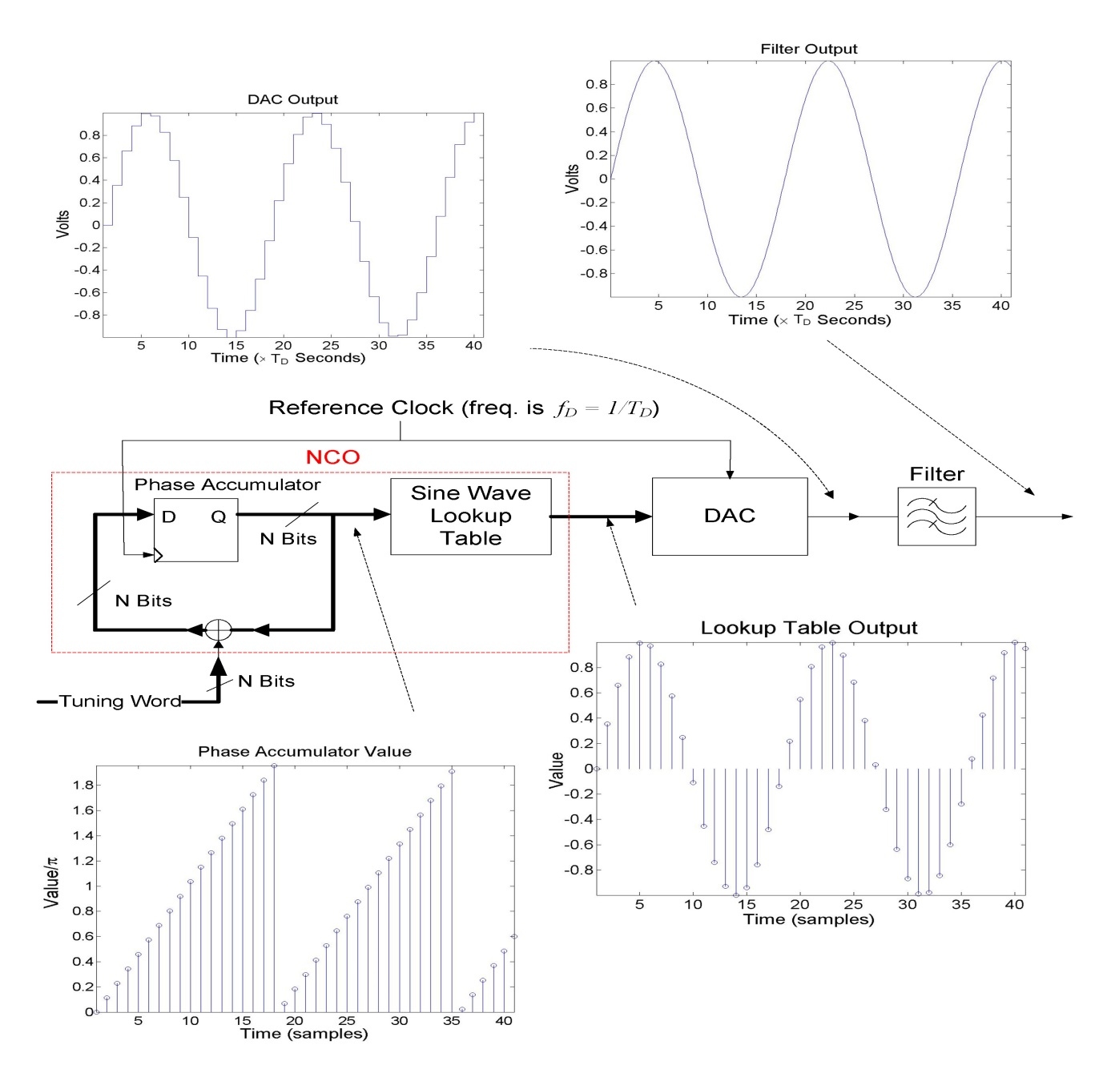
Another way to look at the DDS

Slide 12
DDS advantages (very hard to achieve with VCOs or VCXOs)
The sine wave FREQUENCY is digitally tunable (typically with sub-Hertz resolution).
The sine wave PHASE is digitally adjustable, as well, with only a slight increase in circuit complexity. Since DDS is digital and the frequency & phase are determined numerically, there are NO ERRORS from drift due to temperature or aging of components
Sine/Cosine with EXACT 90 degree offset (or sinusoids with other offsets) can be generated with additional phase-to-amplitude converters + DAC

Slide 13
Introduction to DDS
DDS restrictions:
The output FREQUENCY must be less than or equal to 1/2 the clock source frequency.
The sine wave AMPLITUDE is fixed. This can be modified by additional circuitry.
Since the sine wave is digitally generated by using sampling techniques, the user must be willing to accept a certain amount of DISTORTION. That is, the sine wave is not spectrally “pure” (but impurities can be reduced to a negligible level with proper design and resources)

Slide 14
Fundamental DDS Architecture
A Basic DDS
Accumulator
N-bits
P-bits
Angle to | D-bits
Amplitude Converter
Sampled Sine
Wave
Tuning Word
IN
DAC
N-bits
CLOCK

Slide 15
Fundamental DDS Architecture
Sine Wave Synthesis
Accumulator
Tuning Word IN
Angle to
Amplitude Converter
Sampled Sine Wave
N-bits
P-bits
D-bits
DAC
N-bits
- Amplitude +
₂N
₂P
Phase
Phase
0
0
Phase
Truncated Phase
Angle to Amplitude Transformation
Quantized Amplitude
Sampled Sine Wave

Slide 16
Fundamental DDS Architecture
The “Phase Wheel” Concept:
8
+1
• C = 32
5
4
Instantaneous value of the accumulator output.
•Accumulator capacity
3
• T = 5
2T
T
2
7T
A M P L I T U D E
•Tuning word value
1
P H A S E
0
16
3T
32 = 2^{N} = C
0
• N = 5
6T
31
•Accumulator bits
4T
5T
For this particular case, one revolution around the phase wheel requires 6.4 clock cycles (C/T=6.4).
24
-1

Slide 17
Fundamental DDS Architecture
Determining the output frequency (F_{o}) of a DDS
F_{o} depends on 3 parameters:
  F_{s} the DDS clock frequency
  C the accumulator capacity where C = 2^{N}
  M the tuning word value where 0 < M < C/2
  Definition of frequency:
f = δΦ/δt
(i.e., the derivative of phase w.r.t. time)

Slide 18
Fundamental DDS Architecture
DDS output frequency (cont’d)
δt is the duration of a DDS time step, namely 1/F_{s}
  δt = 1/F_{s}
δΦ is the phase angle change in time interval, δt.
  Note that the tuning word is the amount by which the accumulator increments on each DDS time step (δt).
  Therefore, δΦ is the ratio of the tuning word to the capacity of the accumulator (T/C).
  Since C=2^{N}, we have:
  δΦ = M/ 2^{N}

Slide 19
Fundamental DDS Architecture
DDS output frequency (cont’d)
Combining these results gives the frequency (F_{o}) of the output sine wave as:
F_{o} = F_{s}M / 2^{N}

Slide 20
Fundamental DDS Architecture
How Many Phase Bits?
Accumulator
Phase to
Amplitude Converter
Sampled Sine Wave
Tuning Word IN
N-bits
P-bits
D-bits
DAC
N-bits
CLOCK
The Phase to Amplitude Converter must generate amplitude values that are accurate to 1/2 LSB of the DAC.
To accomplish this,
P requires at least 4 more bits than the DAC

Slide 21
Fundamental DDS Architecture
Amplitude
sin(θ)
1/2 LSB = 2^{-(D+1)}
θ
φ
0
2π

Slide 22
Errors in a DDS System
PHASE ACCUMULATOR
N = 24 to 48 BITS
N
N
DELTA PHASE REGISTER M
N
N
PHASE REGISTER
N
p
PHASE-TO
AMPLITUDE
CONVERTER
M
CLOCK
PHASE TRUNCATION 12-19 BITS
FREQUENCY CONTROL M = TUNING WORD
AMPLITUDE QUANTIZATION
F_{s}
DAC
SYSTEM CLOCK
DAC ERRORS
F
out
Notes:
Run animation
The heart of the DDS system is the phase accumulator whose contents are updated once each clock cycle. Each time the phase accumulator is updated, the digital number, M, stored in the delta phase register is added to the number in the phase accumulator register. Assume that the number in the delta phase register is 00...01 and that the initial contents of the phase accumulator is 00...00. The phase accumulator is updated by 00...01 on each clock cycle. If the accumulator is 32-bits wide, 2^32 clock cycles (over 4 billion) are required before the phase accumulator returns to 00...00, and the cycle repeats.
The truncated output of the phase accumulator serves as the address to a sine (or cosine) lookup table. Each address in the lookup table corresponds to a phase point on the sinewave from 0° to 360°. The lookup table contains the corresponding digital amplitude information for one complete cycle of a sinewave. The lookup table therefore maps the phase information from the phase accumulator into a digital amplitude word, which in turn drives the DAC. In practice, only data for 90° is required because the quadrature data is contained in the two MSBs. In order to further reduce the size of the lookup tables, various proprietary algorithms have been developed to compute the sine values, however, the fundamental concept is still the same.
For an n-bit phase accumulator (n generally ranges from 24 to 32 in most DDS systems), there are 2^{n} possible phase points. The digital word in the delta phase register, M, represents the amount the phase accumulator is incremented each clock cycle. If f_{c} is the clock frequency, then the frequency of the output sinewave is equal to Mf_{c}/2^{n}. This equation is known as the DDS "tuning equation." Note that the frequency resolution of the system is equal to f_{c}/2^{n}. For n = 32, the resolution is greater than one part in four billion! In a practical DDS system, all the bits out of the phase accumulator are not passed on to the lookup table, but are truncated, thereby reducing the size of the lookup table without affecting frequency resolution. The amount of truncation depends upon the resolution and performance of the output DAC. In general, the phase address information should have two to four bits more resolution than the DAC, but this can vary some from product to product. The objective is to use enough resolution in the lookup table address so that the overall noise and distortion of the analog output signal is limited by the DAC and not the effects of phase truncation.

Slide 23
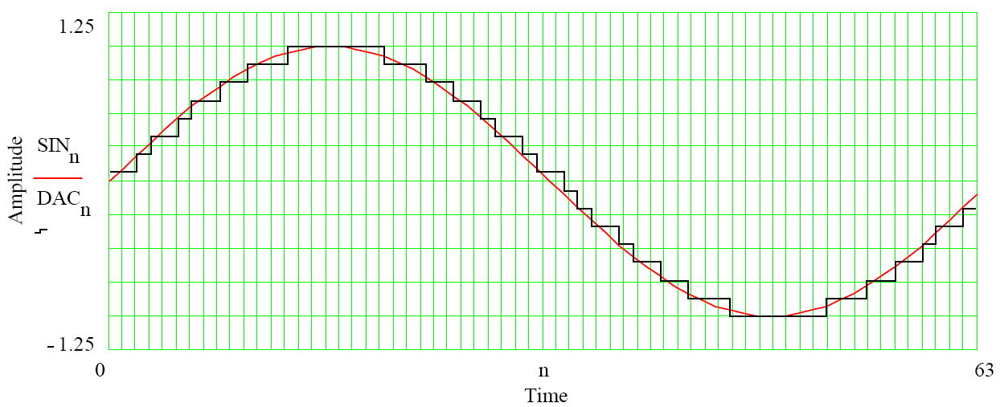
Amplitude Errors
Quantized waveform ≠ Sinewave
  Therefore there will be spectral components
  6.02N + 1.76 quantization noise is only valid when clock and data are uncorrelated. NOT THE CASE for a DDS!
DAC non-linearities
  INL and DNL spurs will alias
  Harmonics from the analog output stage will NOT alias
Notes:
Much of this was covered in a previous seminar.
In a DDS, the output frequency is directly dependent on the clock frequency. Therefore they are highly correlated. Still, picking an odd number for M helps a lot (see next 2 slides).

Slide 24
Spectral Characteristics
DDS is a “sampled data system”
Sampled nature of DAC output produces replicated spectra (“images”) of the output frequency.
Zero-order-hold characteristic of the DAC causes the spectrum to be attenuated according to the SIN(x)/x (or SINC) envelope.

Slide 25
Spectral Characteristics
Spectral Consequences of Sampling
Magnitude
Baseband Spectrum
Continuous Spectrum
f
0
^{F}max
Magnitude
Sampled Spectrum (Ideal)
im age im age
Baseband Spectrum
im age
f
0
F_{s}
2F_{s}
3F_{s}
^{F}max
Nyquist (F /2 > F )
s
max

Slide 26
Spectral Characteristics
“Ideal” sampled spectrum occurs when the sample pulses are infinitely narrow.
  That is, in the time domain the width of the sample pulses (T_{s}) approaches 0.
If the sample pulses have finite width (T_{s} > 0), then SIN(x)/x (or SINC) distortion occurs.
In the frequency domain, the SINC “envelope” is characterized by lobes with null points at frequencies that are multiples of 1/T_{s}.

Slide 27
Spectral Characteristics
SINC Envelope sin(x)/x
Magnitude
SINC Envelope
f
0
1/T_{s}
2/T_{s}
3/T_{s}
4/T_{s}

Slide 28
Spectral Characteristics
In a DDS system, the DAC is clocked at the same rate as the accumulator.
This is the DDS sample rate, F_{s}.
Thus, the minimum width of a sample pulse produced by the DAC is 1/F_{s}, which is T_{s}.
This means that in a DDS, the nulls of the SINC envelope are coincident with multiples of the DDS sample rate.

Slide 29
Spectral Characteristics
SINC Envelope
Magnitude
SINC Envelope
f
0
F_{s}/2
F_{s}
2F_{s}
3F_{s}
4F_{s}

Slide 30
Spectral Characteristics
A DDS is a sampled system
A sampled system produces images of the baseband spectrum at multiples of the sample rate.
The finite pulse width resulting from the operation of the DAC distorts the spectrum by attenuating the baseband signal and its images based on the SINC envelope.

Slide 31
Spectral Characteristics
The output of a basic DDS is a single tone (i.e., a sine wave at a specific frequency).
Since the DDS is a sampled system, the actual output signal is the desired tone PLUS its images.
The images must be filtered out in order to provide a spectrally “pure” sine wave.

Slide 32
Spectral Characteristics DAC Nonlinearity
Sampling causes images of the Nyquist region to appear at multiples of F_{s}.
(Attenuation due to the SINC envelope is not shown)
Magnitude
-Nyquist
Nyquist
f
0
F_{s} 2F_{s}
Nyquist Region is Imaged at Multiples of F_{s}
3F_{s}

Slide 33
After the DAC – and ignoring small spurs
Now we need to filter (in the analog domain) in order to get just the frequency we want

Slide 34
Spectral Characteristics
Pure vs Synthesized Sine Wave
Magnitude
F_{o}: desired DDS output frequency
F_{s}: DDS clock frequency
f
F_{o} F_{s}/2
F_{s}
2F_{s}
Pure Sine Wave
3F_{s}
4F_{s}
Magnitude
SINC Envelope
2F_{o}
Fundamental
Image
2F_{o}
2F_{o}
2F_{o}
f
F_{o} F_{s}/2
F_{s}
2F_{s}
Sampled Sine Wave
3F_{s}
4F_{s}

Slide 35
Spectral Characteristics
ODD and EVEN Nyquist Zones
Magnitude
Fundamental
Image
f
F_{o} F_{s}/2
F_{s}
2F_{s}
3F_{s}
4F_{s}
Nyquist Zone
1
2
3
4
5
6
7
8
etc.

Slide 36
Spectral Characteristics
ODD and EVEN Nyquist Zones:
A Nyquist zone spans a frequency range of F_{s}/2.
ODD zones
A change in the frequency of the fundamental results in an equal change in frequency of the half image
EVEN zones
A change in frequency of the fundamental results in an equal but opposite (negative) change in the frequency of the half image

Slide 37
Spectral Characteristics
Filtering the DDS Output
Accumulator
Tuning Word
Phase to Amplitude Converter
"Pure" Sine Wave
N-bits
P-bits
D-bits
DAC
RCF
IN
N-bits
Sampled
Sine Wave
Magnitude
Reconstruction Low Pass Filter
Reconstruction filter removes the unwanted images
f
F_{o} F_{s}/2
F_{s}
2F_{s}
3F_{s}
4F_{s}

Slide 38
DDS as a Building Block
The fact that a DDS internally generates a digital
sinusoidal wave can be used to great advantage.
Combining the digital DDS core with additional signal processing blocks makes possible:
  Frequency “agile” clock generators
  Frequency and/or Phase “agile” modulators
      FSK, PSK, QPSK, n-QAM, OFDM
  Frequency swept (chirp) modulators

Slide 39
DDS as a Building Block Clock Generator
A DDS-based Clock Generator
Frequency Reference | Clock IN (f)
PLL (M)
 | M x f
SINEWAVE:
High frequency resolution
Programmable
CLOCK:
Precise frequency
Low jitter
COS
Reconst Filter
COMPARATOR
DDS Core
DAC
Clock OUT
Tuning Word
SIN
(digital)
DC Reference

Slide 40
Generating a Clock With a DDS
External filtering removes unwanted images
A squaring circuit converts the signal back to a digital clock
Notes:
The primary challenge in using DDS systems for clock generation is reducing the time jitter that is generated due to the discrete spurious components that are present on the DDS output signal.
These spurious components are primarily due to the quantized nature of the DDS output signal and the phase noise produced because of phase truncation within the DDS.
This figure shows time and frequency domain representations at each point in the process. A real-world representation of the frequency domain is shown at the bottom of the figure. This response contains aliases of higher order harmonics of the output signal which fall close to the desired output signal, and filtering becomes difficult.
The overall quality of the final clock output of a DDS system is determined primarily by the filter and the limiter.
AN-823 discusses the results of experiments conducted with a high performance DDS and clock distribution IC and shows the jitter associated with various filter configurations.

Slide 41
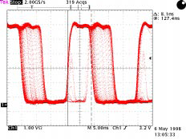
Why You Need a Reconstruction Filter
Fout = 56 MHz, Fclk = 175 MHz
  The MSB does not have a consistent pulse width
  Jitter shows up when unfiltered output is fed directly to a comparator
Notes:
This is why you can’t just use the MSB. You need to filter the output. The waveform on slide 12 will have the same problem.

Slide 42
Additional DDS Capabilities
Add Frequency Register
  Sweep
  Chirp
  RAM profiles
Amplitude control
Modulation/Demodulation
Multi-DDS
  For arrays
  Phase offset/compensation

Slide 43
Signal Transmission & Reception
Low-frequency source information (analog or digital)
Transmission medium (channel)
Modulator and frequency up-converter
Power amplifier
Amplifier
Frequency down-converter
Filter
High-frequency oscillator
High-frequency local oscillator
Transmitter
Receiver

Slide 44
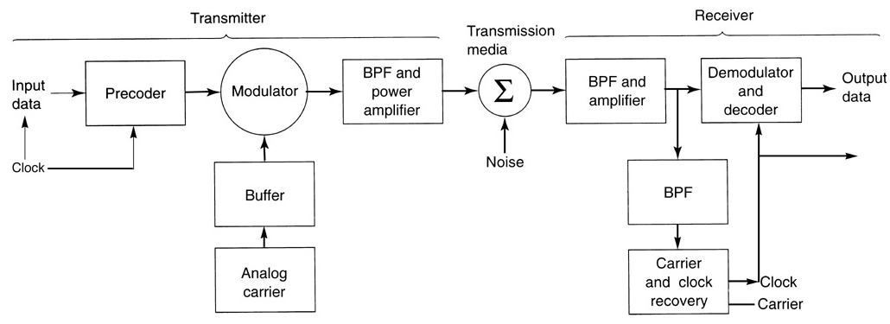
Block diagram of a digital radio system

Slide 45
Modulation principle
Change parameters of a carrier
Information signal: A_{c}(t)
f_{c}(t)
θ_{c}(t)
A_{c}(t) : amplitude modulation AM ASK
f_{c}(t) : frequency modulation FM FSK
θ_{c} (t) : phase modulation PM PSK
A_{c}(t) and θ(t) ⇒ QAM (Digital)
Analog
Digital

Slide 46
Demodulation principle
Recovering of information signal from the received modulated transmission signal
Example:
AM: transmitted signal
Demodulation: multiply with in the receiver

Slide 47
DDS as a Building Block Digital Modulator
A DDS-based modulator requires some additional digital signal processing blocks:
Digital multipliers
Digital adders
Input logic to accept digital modulation data
Data rate translator (optional)

Slide 48
Amplitude-shift keying (ASK or OOK)
unmodulated carrier
t
modulated carrier
t
t
1
0
1
1
0
0
1
T_{b}

Slide 49
Frequency-shift keying (FSK)
A_{c}cos(2πf_{c1}t)
1
t
A_{c}cos(2πf_{c2}t)
0
t
t
1
0
1
1
0
0
1
T_{b}

Slide 50
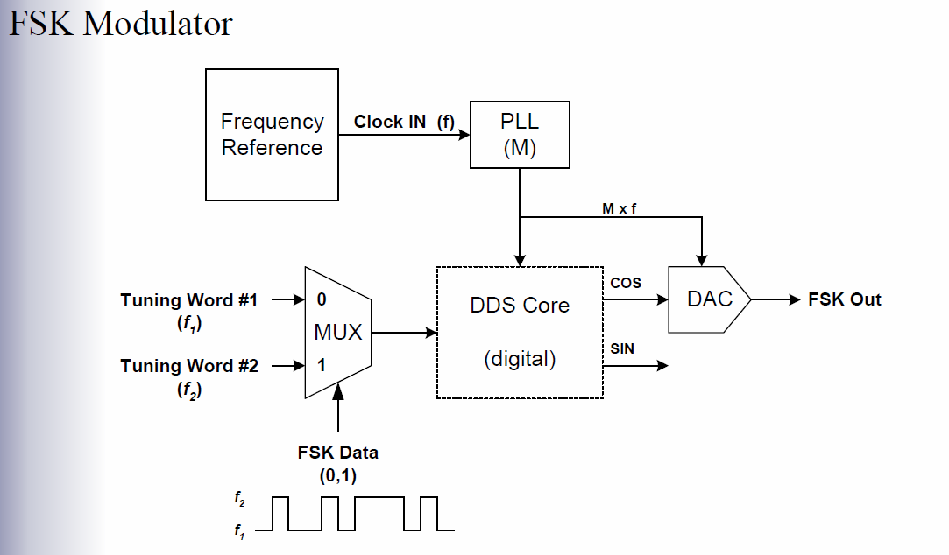
DDS as a Building Block Digital Modulator

Slide 51
DDS as a Building Block Digital Modulator
PSK Modulator
Frequency Reference | Clock IN (f)
PLL (M)
0
0
MUX
1
Phase Offset
M x f
Phase Word
Phase to amplitude
 | SIN
COS
DAC
PSK Out
Accum
PSK Data (0,1)
Shifted Phase
DDS Core
Normal Phase
Tuning Word

Slide 52
Binary Phase-Shift Keying BPSK
A_{c}cos(2πf_{c}t)
0
t
-A_{c}cos(2πf_{c}t)
1
t
t
1
0
1
1
0
0
1
0
T_{b}

Slide 53
DDS as a Building Block Digital Modulator
Quadrature Modulator
Frequency Reference | Clock IN
 | (f)
PLL (M)
M x f
DDS Core
Tuning Word
(carrier=ω_{c})
(digital)
SIN(ω_{c})
COS(ω_{c})
"I" Signal
DAC
Modulated Output
"Q" Signal
Sampler
Digital Modulator

Slide 54
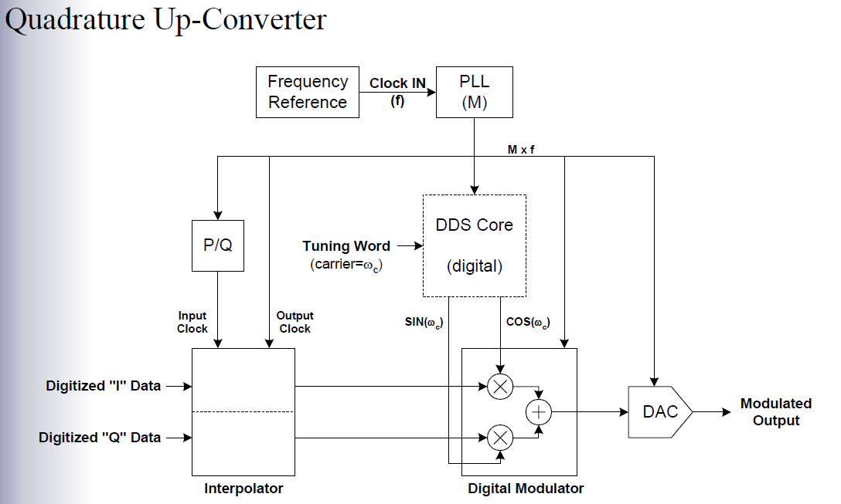
DDS as a Building Block Digital Modulator

Slide 55
DDS as a Building Block Chirp Modulator
Chirp Modulator:
A form of FM (frequency modulation)
Requires the output signal to start at one frequency and gradually “sweep” to another.
For a DDS, this means repeatedly changing the tuning word
value from a value of W₁ to W₂ with a step size (ΔT) such that the “sweep” time requirement is met.
A dual-accumulator DDS effectively accomplishes the “frequency sweep” function.

Slide 56
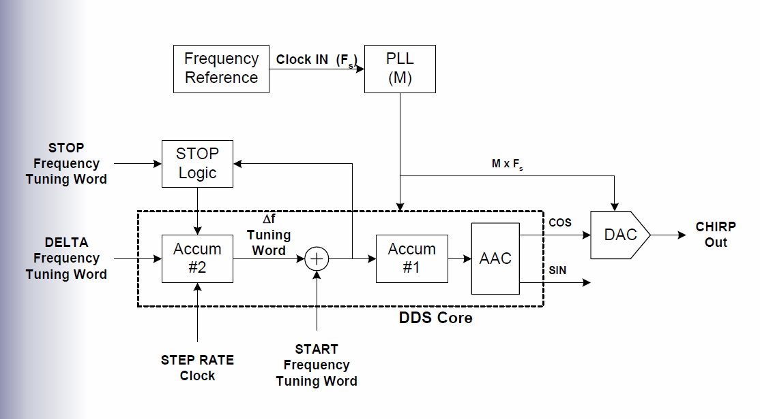
DDS as a Building Block Chirp Modulator

Slide 57
Frequency Control
PHASE ACCUMULATOR
n = 24 - 48 BITS
n
PRE-PROGRAMMED FREQUENCY CONTROL
or RAM
DELTA PHASE REGISTER M
n
n
PHASE REGISTER
n
p
PHASE-TO
AMPLITUDE
CONVERTER
M
CLOCK
FREQUENCY CONTROL M = TUNING WORD
F_{clk}
FREQUENCY
TIME
Notes:
By adding pre-programmed or user-programmed frequency control, the DDS can perform all sorts of sweeps, chirps, or some other arbitrary frequency trajectory. A linear frequency sweep is easily accomplished by adding an additional accumulator.

Slide 58
IQ Modulation
The DDS is the LO for the Quadrature Modulator
  Everything is in the Digital Domain and can be made as perfect as necessary by adding more bits
  Upsampling gives the DDS room to move the signal around
Notes:
Since we can get very accurate 90 degrees phase shift, and since we can get very good IQ balance in the digital domain, quadrature performance is very good. The only analog section is the DAC at the very output. The DDS is actually a very small part of the whole circuit. In fact, the distinction between ADI’s TxDACs and DDS are blurring. This part has 2 ways to control output amplitude – one in the digital domain and one in the analog domain.

Slide 59
Amplitude Control
PHASE ACCUMULATOR
n
n
PHASE REGISTER
n
p
PHASE-TO
AMPLITUDE
CONVERTER
M
DAC
CLOCK
F_{clk}
AMPLITUDE
REGISTER
Notes:
By adding a digital multiplier you can easily do R-Τηετα modulation. We can add RAM or pre-programmed amplitude control.

Slide 60
Multiple DDS
Precise phase control allows use in beam forming systems
  Each DDS starts up in its own phase
  Phase offsets compensate for phase mismatch in analog reconstruction filters
Notes:
All these DDSes are synchronized by a common clock. Note that p=15. Note the DeltaFreq control (i.e., a frequency accumulator – this part has a sweep feature). It also has amplitude control.

Slide 61
Summary
DDS can be used to obtain a variety of precision waveforms
Compared to other frequency generating techniques, a DDS has the following advantages:
  Precise phase control without affecting frequency
  Precise frequency control without affecting phase
  Fast arbitrary phase changes
  Fast arbitrary frequency changes
  Precision modulation
DDS has well known error characteristics
Care must be taken designing the output analog circuitry
Applications abound!

Slide 62
Spectral Characteristics
Additional artifacts in the DDS output spectrum:
Phase truncation spurs
DAC nonlinearity
DAC switching noise

Slide 63
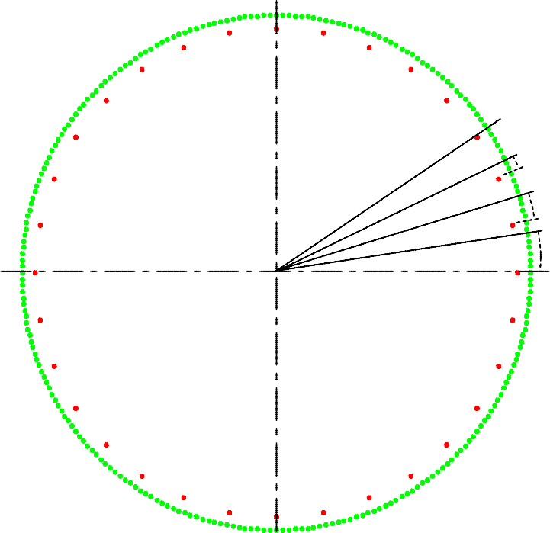
Spectral Characteristics Phase Truncation Spurs
Phase Truncation Error
(8-bit accumulator truncated to 5 bits with a tuning word of 6)
64
8
E3
E2 E1
128 16
0 0
24
192

Slide 64
Spectral Characteristics Phase Truncation Spurs
phase truncation spurs
Rigorous analysis is beyond the scope of this presentation.
However, a practical explanation follows.

Slide 65
Spectral Characteristics Phase Truncation Spurs
The spectral characteristics of phase error are rooted in the time domain behavior of the truncated phase bits.
The behavior of the truncated phase bits can be thought of as a mini-accumulator of width B with an initial tuning word that is composed of only those bit locations that are truncated.

Slide 66
Spectral Characteristics Phase Truncation Spurs
B
T =
0 | 0 | 1 | 0 | 1 | 0 | 1 | 0 | 0 | 0 | 0 | 1 | 0 | 0 | 1 | 1 | 1 | 1 | 0 | 0
Accumulator
Angle to
Amplitude Converter
T
20
8
DAC
20
Ideal Synthesizer
Accumulator
Angle to
T
20
20
Amplitude Converter
DAC
20
Noise Source
Accumulator
Angle to
B
12
12
Amplitude Converter
Scaler
DAC
12

Slide 67
Spectral Characteristics Phase Truncation Spurs
The “noise” source is what generates the phase truncation spurs.
The behavior of the “noise” accumulator is analogous to that of the ideal accumulator, but with its own tuning word.
The phase error accumulates up to the CAPACITY of the noise accumulator. At which point it “rolls over” and the
accumulating process resumes.

Slide 68
Spectral Characteristics Phase Truncation Spurs
Phase Error “Sawtooth” for an Arbitrary Tuning Word
"Noise" Accumulator
Period of Sawtooth
Value
₂B
Repetition begins here
0
Clock "Tics"
0
Grand Repitition Rate (GRR)

Slide 69
Spectral Characteristics Phase Truncation Spurs
Not to worry...
  A properly designed DDS forces the magnitude of the largest truncation error spur to be less than the 1/2 LSB error of the DAC.
  Truncation spur energy is comparable to the energy contained in the integrated DAC noise floor.

Slide 70
Spectral Characteristics DAC Nonlinearity
An “ideal” DAC translates the digital codes at the input to output levels along a straight line.
Normalized Output Level
1
0.5
0
Input Code
0
4
8
12
16
20
24
28
32

Slide 71
Spectral Characteristics DAC Nonlinearity
A “typical” DAC tends to deviate from a straight line.
This nonlinearity leads to harmonic distortion.
Normalized Output Level
1
0.5
Output levels deviate from straight line
0
Input Code
0
4
8
12
16
20
24
28
32

Slide 72
Spectral Characteristics DAC Nonlinearity
The nonlinear transfer function produces harmonics of the fundamental which are aliased into the first Nyquist zone.
First, consider the UNSAMPLED spectrum, below.
Magnitude
Fundamental
2nd harmonic
3rd harmonic
etc...
f
F_{o} F_{s}/2
F_{s} 2F_{s}
Harmonic Distortion (unsampled system)
3F_{s}

Slide 73
Spectral Characteristics DAC Nonlinearity
Since the DAC is a sampled system, the harmonics must be mapped into the Nyquist region.
Magnitude
-Nyquist
Nyquist
Negative image of fund. and 2nd
harmonic
Fundamental
2nd harmonic is in-band and NOT aliased in this example
mapped harmonics (aliases)
unmapped harmonics
f
F_{s} 2F_{s}
Sampling Maps Harmonics Into the Nyquist Region
3F_{s}
0

Slide 74
Spectral Characteristics DAC Switching Noise
High slew rate of digital signals internal to the DAC leads to noise transients being coupled to the DAC output pin(s).
Other high speed signals in close proximity to the DAC from digital circuits on the same silicon die can also couple into the DAC.
This results in high speed switching transients appearing at
the DAC output as a source of noise and further degrades overall performance.

Slide 75
Direct Digital Synthesis Theory & Applications
1. Theory (why & how it works)
2. Error Sources
3. Advanced DDS Capabilities
4. Applications Examples
paul.smith@analog.com

Slide 76
Direct Digital Synthesis Theory & Applications
1. Theory (why & how it works)
2. Error Sources
3. Advanced DDS Capabilities
4. Applications Examples
paul.smith@analog.com
Notes:
14
10
5
4
10
3
15
4
10
3
5
TOTAL 83 MIN
TIME (MIN)

Slide 77
Direct Digital Synthesis Theory & Applications
1. Theory (why & how it works)
2. Error Sources
3. Advanced DDS Capabilities
4. Applications Examples
paul.smith@analog.com
Notes:
14
10
5
4
10
3
15
4
10
3
5
TOTAL 83 MIN
TIME (MIN)

Slide 78
Direct Digital Synthesis Theory & Applications
1. Theory (why & how it works)
2. Error Sources
3. Advanced DDS Capabilities
4. Applications Examples
paul.smith@analog.com
Notes:
14
10
5
4
10
3
15
4
10
3
5
TOTAL 83 MIN
TIME (MIN)

Slide 79
DDS as a Building Block Quadrature Modulation Rule
The modulation signal (I/Q) must be sampled at the same rate as the DDS clock.
If the modulation signal is sampled at a rate lower than the DDS clock, then rate up-conversion (interpolation) is required to synchronize the sampled modulation data with the sampled carrier (the DDS output).
Furthermore, the DDS and modulation data sample rates should have, at the very least, a rational ratio (i.e., P/Q where P and Q are integers).
  An integer ratio offers better hardware efficiency than a rational ratio.
  A power-of-2 ratio is the most hardware efficient of all.

Slide 80
Quadriphase-shift keying (QPSK)
00
t
10
t
11
t
01
t
t
1
0
1
1
0
0
0
1
T_{s}

Slide 81
QPSK Transmitter
X
A_{c}cos(2πf_{c}t)
DDS
+
Binary
bipolar
data sequence
Series to parallel converter
QPSK
signal
∑
-90º
-
A_{c}sin(2πf_{c}t)
X

